Slide 1
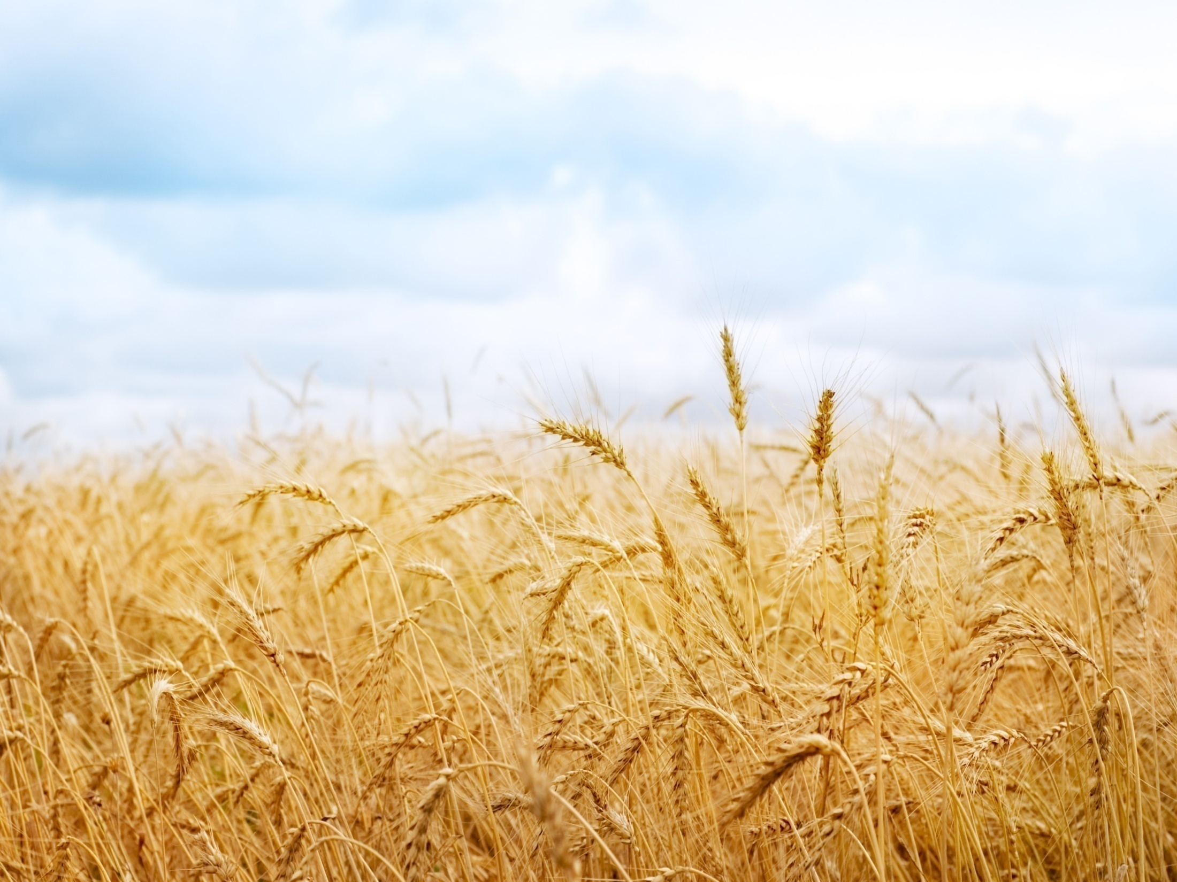
Anna-Data
Farmer’s new smart advisor !

Slide 2

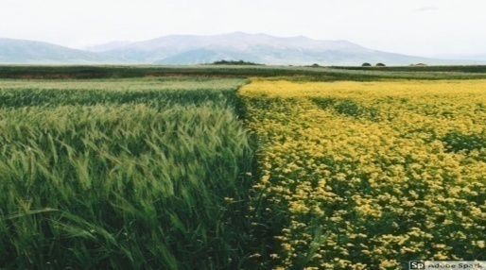
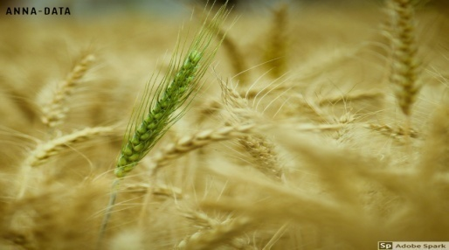
Objective
To convert weather parameters and agricultural data and provide a farmer with
comprehensive actionable advisory about general agricultural aspects.

Slide 3
Now, the big question ...
----------------------------------------------------------------------------------------------------------------------------------
How to reach a farmer?????
Simple, Android App ! It’s cheap . It’s smart. That works !!!!
-----------------------------------------------------------------------------------------------------------------
Can a less educated farmer comprehend info from
a normal predicting app?
No ! So, our app must be really easy to use !
---------------------------------------------------------------------------------------------------------------------
So, Anna-Data is made keeping in mind both these points.

Slide 4
Salient features of Anna-Data App
Easy to use interface.
Deep learning based prediction system
Providing farmer with comprehensive advice
Unique ID to all members

Slide 5
The Frontend

Slide 6
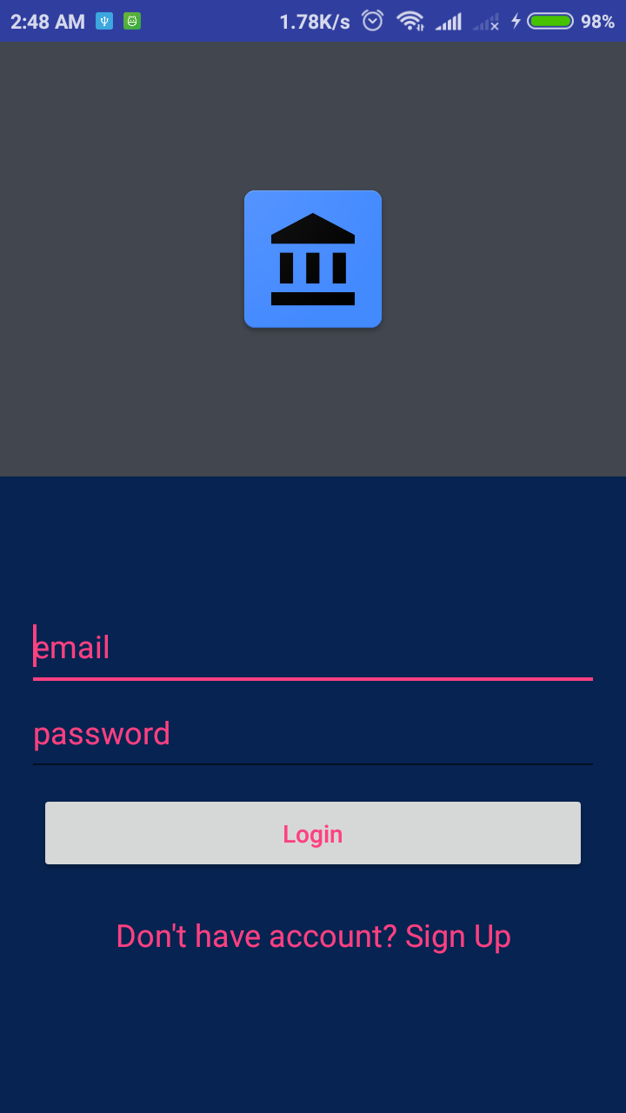
Anna-Data App
The login screen of Anna-Data App.
Every farmer will be allocated a unique ID at this stage in database.

Slide 7
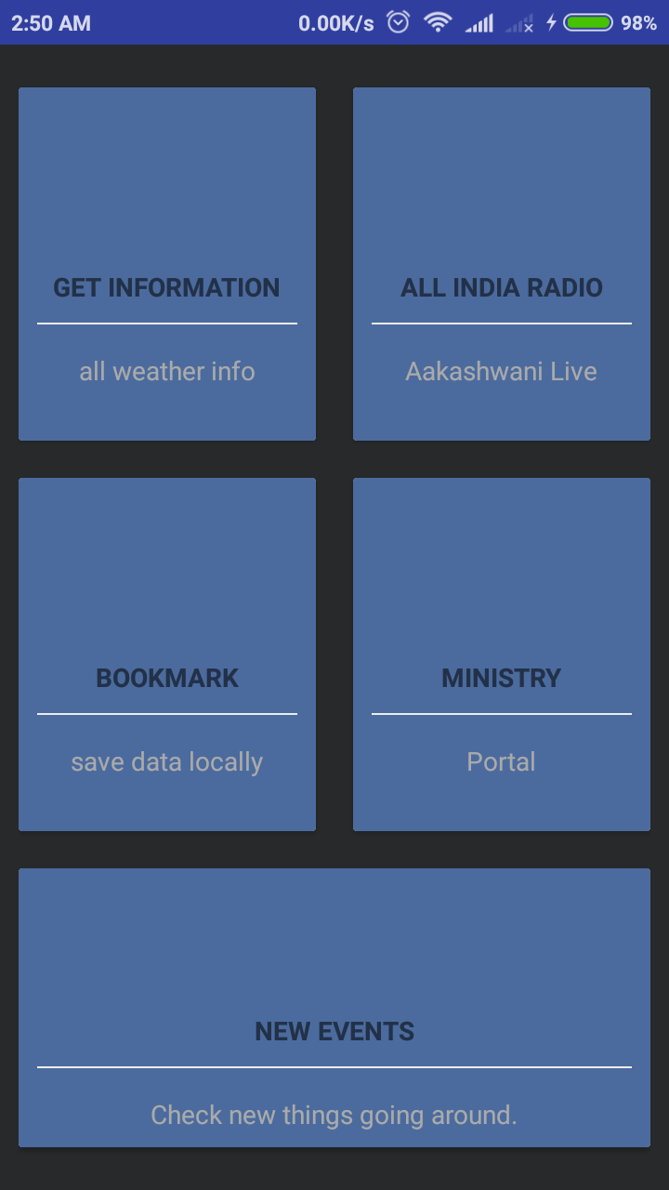
The Dashboard
Here, a farmer is provided with various options to choose from.
Each option when selected will function according to mentioned names !

Slide 8
The Backend !

Slide 9

The backend of the prediction system is based on Machine Learning algorithms.
Machine Learning

Slide 10
The Algorithms used...
SVR : Support Vector Regression
G-NB: Gaussian Naive Bias
LDA: Latent Dirichlet Allocation
SVC-RBF: Support Vector Classifier
B-NB: Bernoulli’s Naive Bias
SGDC: Stochastic Gradient Descent
KNN: K Nearest Neighbour
M-NB: Multinomial Naive Bias
Linear Reg.
Logistic Reg.
Decision Tree

Slide 11
How it works.....
Historical data of a place is trained to a neural network using 6 of the above mentioned techniques through an efficient python code.
The final output is the mean of the outcomes of each of these
techniques. Which is used by the app to produce actionable -
advice !
----------------------------------------------------------------------------------
Here, data of India is trained to predict and advice.
Similarly the weather prediction can be made for any country
across the globe. Hence Anna-Data has a good utility
everywhere.

Slide 12
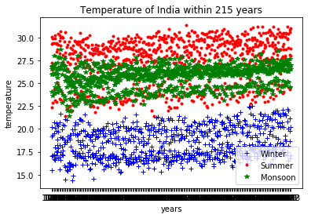
Training for Temperature Prediction
The temperature across different seasons in Indian peninsula for past 215 years is used to train the neural network.
Data Source:

Slide 13
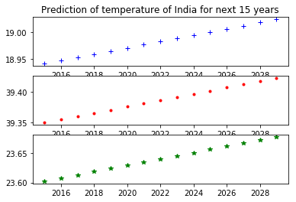
The system is used to predict the temperature of next 15 years as a test. The above output is obtained.

Slide 14
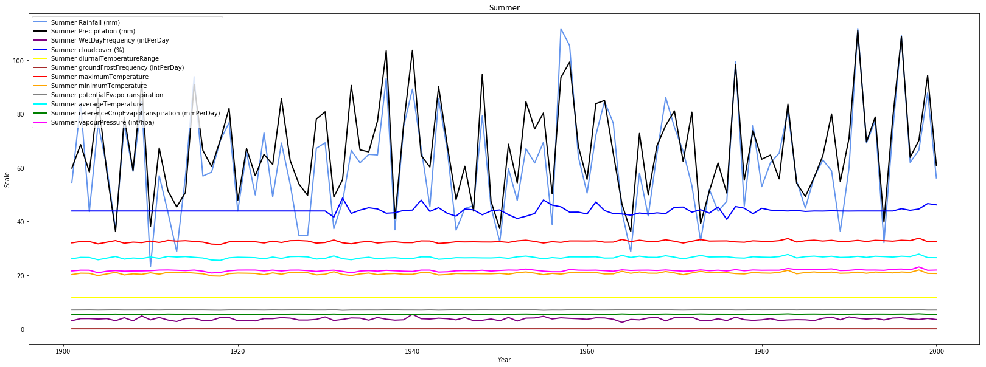
Training Data for Precipitation Prediction during Summer season

Slide 15
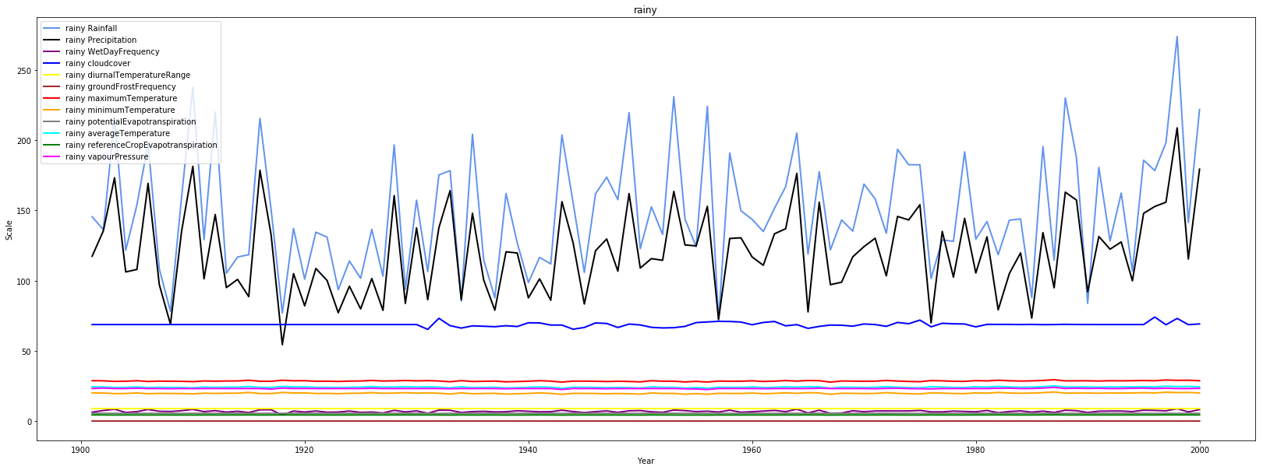
Training Data for Precipitation Prediction during Rainy season

Slide 16
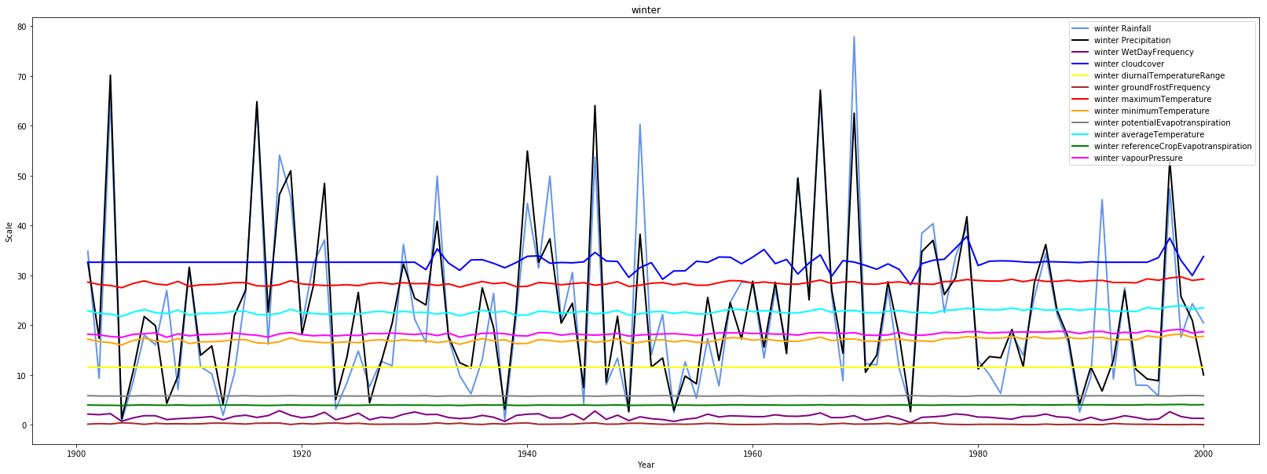
Training Data for Precipitation Prediction during Winter season

Slide 17
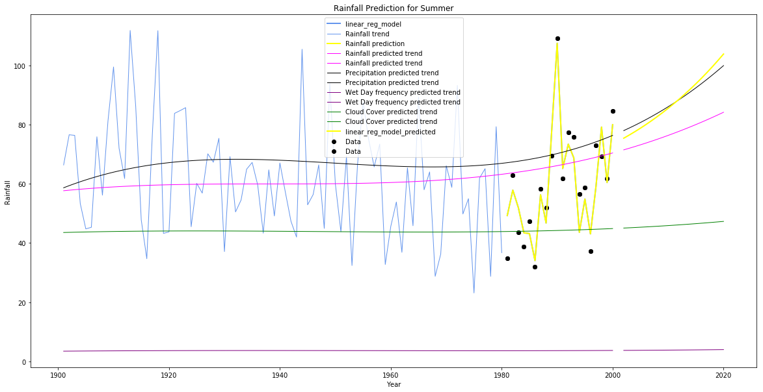
Prediction of Rainfall during Summer season based on the trained data

